Slide 1
Principles of Reliable Data Transfer

Slide 2
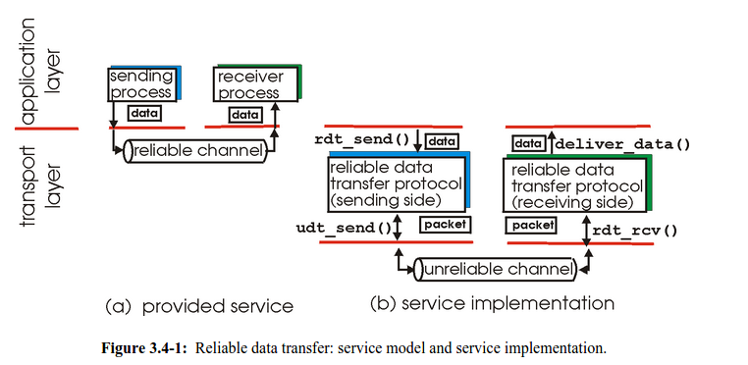
Reliable Data Transfer
Making sure that the packets sent by the sender are correctly and reliably received by the receiver amid network errors, i.e corrupted/lost packets
Important in App..,transport, link layer
Top-10 list of important Networking problem

Slide 3
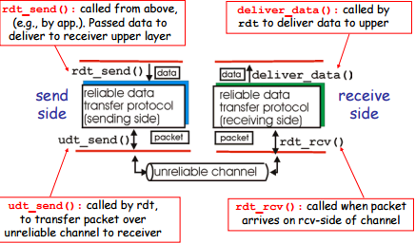
Reliable Data Transfer: Getting Started

Slide 4
Reliable Data Transfer: Getting Started
Consider only unidirectional data transfer
  A sender sending packets to a receiver
  Bidirectional communication is a simple extension, where there are 2 sender/receiver pairs

Slide 5
RDT over Reliable Channel
Underlying Channel Perfectly reliable
No bit errors
No loss of packets
Separate FSMs for Sender, receiver
Sender sends data into underlying channel
Receiver read data from underlying channel

Slide 6
RDT over Unreliable Channel
…
4
3
2
1
…
4
3
2
1
RDT_Send
Deliver_Data
Reliable Data Transfer
Protocol (Sender Side)
Reliable Data Transfer
Protocol (Receiver Side)
UDT_Send
RDT_Receive
Unreliable channel
Channel may flip bits in packets/lose packets
  The received packet may have been corrupted during transmission, or dropped at an intermediate router due to buffer overflow
Notes:
Application may get duplicates in the case of early timeouts

Slide 7
RDT over Unreliable Channel
Two fundamental mechanisms to accomplish reliable delivery over Unreliable Channels
  Acknowledgements (ACK), Negative ACK (NACK)
    Small control packets (header without any data) that a protocol sends back to its peer saying that it has received an earlier packet (positive ACK) or that it has not received a packet (NACK).
    Sent by the receiver to the sender
  Timeouts
    Set by the sender for each transmitted packet
    If an ACK is received before the timer expires, then the packet has made it to the receiver
    If the timeout occurs, the sender assumes that the packet is lost (corrupted) and retransmits the packet

Slide 8
ARQ
The general strategy of using ACKs (NACKs) and timeouts to implement reliable delivery is called Automatic Repeat request (ARQ)
ARQ Mechanisms for Reliable Delivery
  Stop and Wait
  Pipelining

Slide 9
Stop and Wait
Simplest ARQ protocol
Sender:
  Send a packet
  Stop and wait until an ACK arrives
  If received ACK, send the next packet
  If timeout, ReTransmit the same packet
Receiver:
  When you receive a packet correctly, send an ACK
Sender
Receiver
Packet
Time
ACK
Timeout
Packet
ACK
Packet

Slide 10

Performance of Stop and Wait
Can only send one packet per round trip
example: 1 Gbps link, 15 ms e-e prop. delay, 1KB packet:
sender
receiver
first packet bit transmitted, t = 0
last packet bit transmitted, t = L / R
first packet bit arrives
RTT
last packet bit arrives, send ACK
ACK arrives, send next
packet, t = RTT + L / R
  1KB pkt every 30 msec -> 33kB/sec throughput over 1 Gbps link
  network protocol limits use of physical resources!

Slide 11

Pipelining: Increasing Utilization
Pipelining: sender allows multiple, “in-flight”, yet-to-be-acknowledged pkts without waiting for first to be ACK to keep the pipe full
  Capacity of the Pipe = RTT * BW
sender
receiver
first packet bit transmitted, t = 0
last bit transmitted, t = L / R
first packet bit arrives
RTT
last packet bit arrives, send ACK
last bit of 2nd packet arrives, send ACK
last bit of 3rd packet arrives, send ACK
ACK arrives, send next
packet, t = RTT + L / R
Increase utilization
by a factor of 3!

Slide 12
#THANK YOU

